Slide 1
DOM and Window

Slide 2
Window

Slide 3
Window
There’s a “root” object called window. It has two roles:
First, it is a global object for JavaScript code, as described in the chapter Global object.
Second, it represents the “browser window” and provides methods to control it.

Slide 4
Window
function sayHi() { alert("Hello"); } // global functions are accessible as properties of window window.sayHi();

Slide 5
Window
alert(window.innerHeight); // inner window height

Slide 6
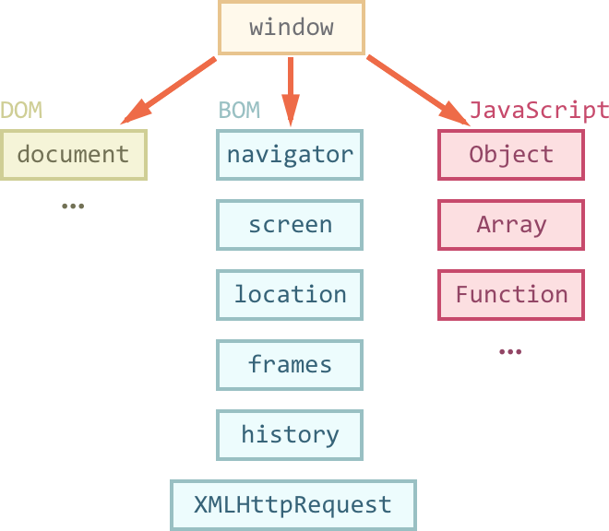
Window

Slide 7
Document Object Model (DOM)

Slide 8
Document Object Model (DOM)
<!DOCTYPE html>
<html>
<head>
<title>
My title
</title>
</head>
<body>
<h1>
My header
</h1>
<a href="">
My link
</a>
</body>
</html>

Slide 9
Document Object Model (DOM)
When a web page is loaded, the browser creates a Document Object Model of the page.
The HTML DOM model is constructed as a tree of Objects:

Slide 10

Document Object Model (DOM)

Slide 11
Document Object Model (DOM)
With the object model, JavaScript gets all the power it needs to create dynamic HTML:
JavaScript can change all the HTML elements in the page
JavaScript can change all the HTML attributes in the page
JavaScript can change all the CSS styles in the page
JavaScript can remove existing HTML elements and attributes
JavaScript can add new HTML elements and attributes
JavaScript can react to all existing HTML events in the page
JavaScript can create new HTML events in the page

Slide 12
DOM methods and properties
In the DOM, all HTML elements are defined as objects.
HTML DOM methods are actions you can perform (on HTML Elements).
HTML DOM properties are values (of HTML Elements) that you can set or change.

Slide 13
DOM methods and properties
<html>
<body>
<p id="demo"></p>
<script>
document.getElementById("demo").innerHTML = "Hello World!";
</script>
</body>
</html>

Slide 14
DOM methods and properties
The getElementById Method
The most common way to access an HTML element is to use the id of the element.
In the example above the getElementById method used id="demo" to find the element.
The innerHTML Property
The easiest way to get the content of an element is by using the innerHTML property.
The innerHTML property is useful for getting or replacing the content of HTML elements.

Slide 15
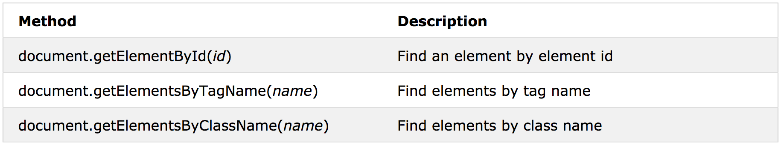
Finding, Changing, Adding and Removing elements
Finding HTML Elements

Slide 16
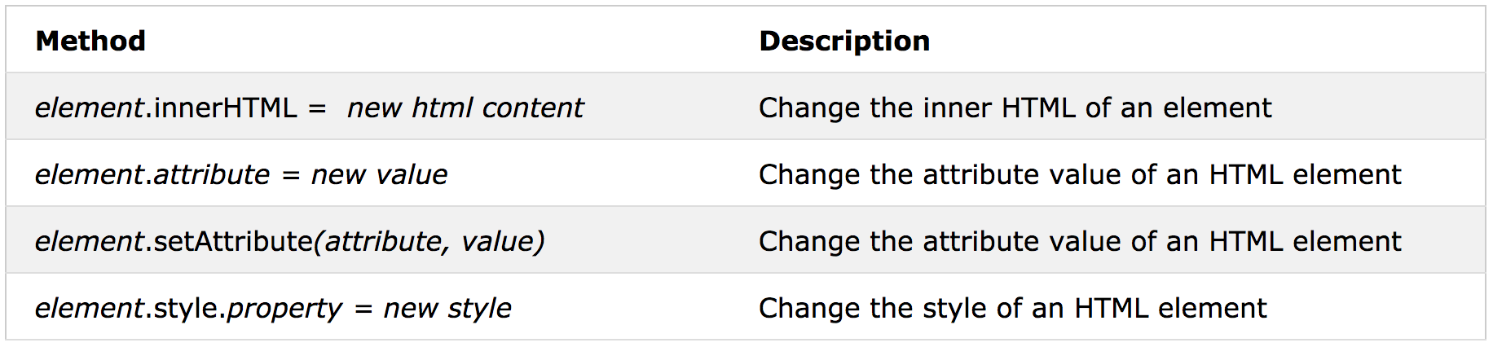
Finding, Changing, Adding and Removing elements
Changing HTML Elements

Slide 17
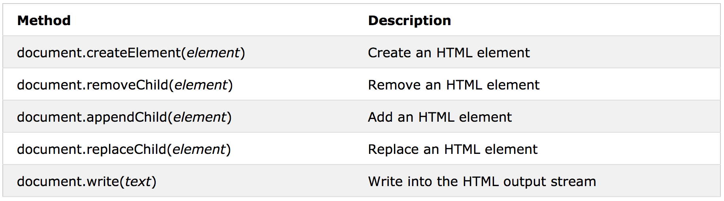
Finding, Changing, Adding and Removing elements
Adding and Deleting Elements

Slide 18
Finding HTML Elements
Finding HTML Element by Id
var myElement = document.getElementById("intro");
Finding HTML Elements by Tag Name
var x = document.getElementsByTagName("p");
This example finds the element with id="main", and then finds all <p> elements inside "main":
var x = document.getElementById("main");
var y = x.getElementsByTagName("p");

Slide 19
Finding HTML Elements
Finding HTML Elements by Class Name
var x = document.getElementsByClassName("intro");
Finding HTML Elements by CSS Selectors
var x = document.querySelectorAll("p.intro");

Slide 20
Attributes and styles
Changing the Value of an Attribute
document.getElementById(id).attribute = “new value”;
Changing HTML Style
document.getElementById(id).style.property = “new style”;

Slide 21
Creating New HTML Elements
<div id="div1">
<p id="p1">This is a paragraph.</p>
<p id="p2">This is another paragraph.</p>
</div>
<script>
var para = document.createElement("p");
var node = document.createTextNode("This is new.");
para.appendChild(node);
var element = document.getElementById("div1");
element.appendChild(para);
</script>

Slide 22
Removing Existing HTML Elements
<div id="div1">
<p id="p1">This is a paragraph.</p>
<p id="p2">This is another paragraph.</p>
</div>
<script>
var parent = document.getElementById("div1");
var child = document.getElementById("p1");
parent.removeChild(child);
</script>

